Slide 1
PMIC Insight - II
In this Issue
Contacts:
Sobia Maqbool
Head of Research
sobia.maqbool@pmic.pk
Naureen Bakhsh Chaudhry
Manager – Sector Development Unit
Naureen.bakshs@pmic.pk
Agri Value Chain Project - PMIC
Focusing Inward
Focusing Outward
Learning Hub
Sustainable Development Goal 2
The Economics

Slide 2
Agriculture Value Chain Project - PMIC
Problems of Small Farmers
Interventions
Results
Lack of knowledge, awareness and resistance in employing latest farming techniques
Exposure to high risk due to threat of natural calamities
Capital constraints
Dependence on middlemen for financial and non-financial needs, who often employ exploitative techniques
Lack of connectivity to markets
Improved income stream for farmers
Larger size loans for crop cultivation
Provision of Crop Loan Insurance in addition to standard Life and Health Insurance facility
Trainings on latest farming practices & farm visits by Fauji Fertilizer Company’s Agri Extension Services department
Trainings resulted in decrease of input costs due to efficient use of fertilizer and water
Provision of credit allowed farming activities to be undertaken in a timely manner
Soil sampling & testing
Cotton picking training for women
Backward and Forward linkages with agriculture input providers and agriculture produce purchasing entities
Adoption of good agricultural practices & quality inputs resulted in enhanced yields
Social mobilization & awareness sessions
Formation of Farmer Enterprise Groups (FEGs)
Connectivity with ginning/cotton factories, PASCO and corporate buyers allowed better prices to be realized for the produce
Backward linkages provided access to quality seeds and fertilizers
Theory of Change
Using a value chain approach to agriculture financing involving awareness and training for farmers, provision of capital and creation of backward & forward linkages can put the farmers on the path to prosperity
Implementing Partners
Pakistan Microfinance Investment Company Limited
NRSP Microfinance Bank
Sona Welfare Foundation
Areas of Intervention
2017: Tehsil Ahmad Pur East of District Bahawalpur; Number of Farmers - 1,000
Overall: 3 pilots undertaken collectively by PMIC (ex-Micro Finance unit of PPAF), along with NRSP-MFB and SWF over the last 5 years; to-date benefitted more than 17,000 subsistence farmers in district Bahawalpur
What’s Next?
As part of the plan to upscale its initiatives, PMIC and SWF have recently signed an MOU of Rs. 260m to implement Agriculture Value Chain project for 5,000 smallholder rice farmers, in districts Nankana Sahib, Sheikhupura and Gujranwala
About PMIC
About NRSP MFB
About SWF
Established in October 2016, PMIC is a vital player in the financial services eco-system of Pakistan. PMIC is focused on improving employment and livelihood opportunities for marginalized segments in the country especially women and youth, while also creating equitable access to financial services within rural communities. The sponsors of PMIC include PPAF, Dfid through Karandaaz and KfW.
NRSP MFB, established in 2011, is licensed by the SBP to operate as a nationwide microfinance bank. The bank provides microfinance services to the rural low income sector with an overall objective of mitigating poverty and promoting social welfare. Its equity capital has been contributed by IFC, Acumen, KFW and National Rural Support Programme.
SWF is the Corporate Social Responsibility arm of Fauji Fertilizer Company (FFC). SWF has been engaged with PMIC/PPAF and NRSP-MFB for the last 3 years and have been working to help add value in the lives of poor farmers in rural areas of Pakistan.

Slide 3
Focusing inward
From 2015 to 2017, the gross loan portfolio outstanding in the microfinance sector has more than doubled from Rs. 93b to Rs. 203b, with average outstanding loan balance also increasing, particularly for MFBs to Rs. 53,000. Alongside growth, institutions continue to invest in systems and control environment.
However, in the absence of a centralized database where data from all microfinance providers would be collated, it is difficult to ascertain client indebtedness. MFBs are reporting only into e-CIB since November 2016 while NBMFIs are reporting to a private sector entity and do not have access to e-CIB. The risk of over-indebtedness is magnified by the pace at which the microfinance sector is growing. Given the significance of the microfinance sector in not just enhancing financial inclusion but many of the targets under the Sustainable Development Goals, necessary action to manage the sector risks are urgent and necessary.
Is the sector exposed to risk of over indebtedness?
Digital Credit is often defined in terms of three attributes – instant, automated and remote. As a CGAP paper on Consumer Protection in Digital Credit* notes, these very three attributes create consumer protection risks that are distinct from those of traditional credit. What is encouraging to note is that many of the practices explored around areas such as disclosures, marketing, suitability & product design, repayment & collections, and credit reporting & information sharing are a win-win as they bring benefits to lenders as well as their customers.
As institutions in Pakistan venture into the digital credit space, some of the questions to keep in mind include: Do the disclosures provide clear presentation of costs, payment terms, and other information to the borrower before the loan is accepted? Have sufficient measures been taken to increase borrower intentionality? Are lenders thinking about optimizing the effect of repayment messages and incorporating flexible payments and debt restructuring in an automated environment?
Finally, something for the regulator to consider is whether there should be new standards developed for digital credit that take into account the nuances specific to this model of lending. It is almost easy to forget that most digital lending is high cost consumer lending; this by itself creates strong argument for standards on appropriate product design and consumer protection measures.
http://www.cgap.org/sites/default/files/Focus-Note-Consumer-Protection-in-digital-Credit-Aug-2017.pdf
Consumer Protection in the Digital Space

Slide 4
Focusing outward
‘Impact Investing’ a term coined in 2007, has now gained momentum as a key area of focus and investment tool to make meaningful impact in the lives of the underserved. According to the GIIN Annual Impact Investor Survey 2017, 205 respondents of the survey invested USD 22.1 billion in nearly 8,000 impact investing transactions in 2016. The respondents envisaged to increase the volume of invested capital by 17% and the number of deals by 20% in 2017. In aggregate, 209 respondents were managing USD 114 billion in impact investing assets at end-2016. The main focus areas in terms of assets under management by the impact investors were identified to be housing (22%), energy (16%), microfinance (12%) and other financial services (10%), food and agriculture (7%) and healthcare (6%). Another key finding of the survey was that investors looking to achieve market rate returns were more likely to make microfinance and energy related investments, especially in South Asia.
Impact investing and microfinance complement each other with their double bottom line objectives. With the evolution of the microfinance sector in Pakistan and a desire to cater to varying needs of customers beyond traditional loans, there is potential to tap into impact related funds seeking social and financial returns in areas such as agriculture, energy, education, to name a few. Such investments can facilitate the creation of a complete eco-system to support those living at the base of the pyramid.
Impact Investing & Microfinance
CGAP’s publication on ‘Female Smallholders in the Financial Inclusion Agenda’* provides an insight into the link between financial inclusion for smallholder families and sustainable agricultural development, which is also identified as an important element in the Sustainable Development Goals. The challenge to financially include female smallholders is identified as a potential business opportunity for Microfinance Providers (MFPs). Adequate understanding of female smallholders’ goals, livelihoods and cashflows can help the MFPs to develop financial products bundled with value addition services that meet the needs and requirements of the female smallholders.
The FAO report on ‘Women in Agriculture in Pakistan’*, indicates that 72% of females are associated with agriculture out of the total labor force in Pakistan. Though the contribution of females in livestock and agriculture activities has been evidenced across the country, there is a knowledge gap in relation to smallholder farmers in general in Pakistan which is more pronounced in case of female smallholder farmers. Stakeholders need to coordinate efforts towards design and implementation of female centric financial and non-financial services for smallholder farmers in Pakistan while ensuring inclusion of females in initiatives such as agriculture value chains for smallholder female farmers.
* http://www.cgap.org/publications/female-smallholders-financial-inclusion-agenda
** http://www.fao.org/3/a-i4330e.pdf
Female Smallholders in the Financial Inclusion Agenda

Slide 5
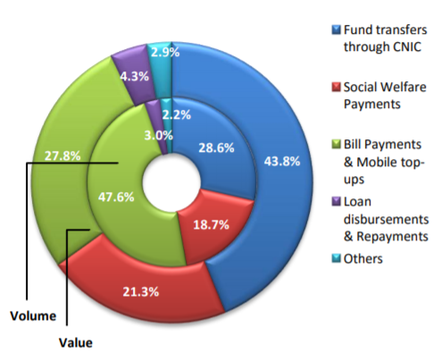
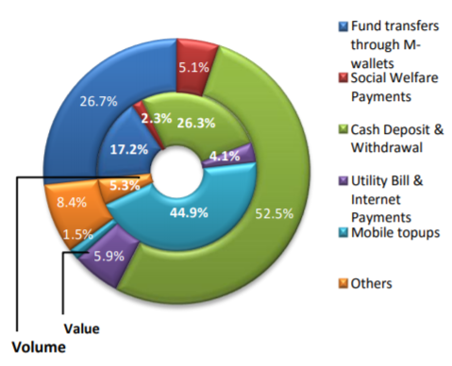
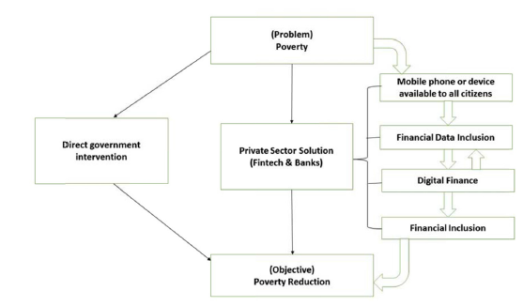
Learning Hub
Question of the Quarter
Case Study
Digital Finance Landscape - Pakistan
What is Digital Finance?
M-Pesa- Financial Inclusion in Kenya*
Termed as “Laboratory for Innovation” by CGAP, Pakistan took the first step with ‘EasyPaisa’ in the domain of Branchless Banking operations and there are now 11 BB service providers in the country with varying levels of services
BB transactions can happen either over-the-counter (OTC) or through m-wallet; in recent quarters, the proportion of transactions through m-wallet has increased to almost two-thirds. The primary reason for decline in OTC transactions is that SBP made it mandatory for banks to conduct Person-to-Person transactions only through the Biometric Verification System-BVS devices starting Jul-2017; installation for which is underway at a number of agent locations
Despite significant potential for enhancing financial inclusion through digital platforms, given the level of mobile phone penetration, the actual level of success has been less than desired. Many attribute it to a lack of complete eco-system around digital financial services
Will developments such as Ant Financial’s 45% stake in Telenor Bank, set the stage to transform the financial inclusion landscape in Pakistan?
How will the new licensing criteria for digital banks being developed by SBP change the digital finance landscape in Pakistan ?
Definition
Challenges
Digital finance is financial services delivered through mobile phones, personal computers,
the internet or cards linked to a reliable digital payment system without the need
to visit a bank branch or without dealing directly with the financial service provider.
Prior to M-Pesa’s launch, only 27% adults had access to financial services and only 11% of the rural population used a bank
Remittances were prevalent but majorly through informal sources
Is it relevant?
M-Pesa Success
According to the World Bank, digital finance can lead to greater financial inclusion, expansion of financial services to non-financial sectors, and the expansion of basic services to individuals, since nearly 50% of people in the developing world already own a mobile phone.
CGAP identifies significant potential for the provision of affordable, convenient and secure banking services to poor individuals in developing countries through digital finance channels
Digital finance can contribute towards economic stability, financial intermediation and facilitate governments by providing a platform for payments
Digital finance should improve the welfare of individuals and businesses that have formal bank accounts and have funds in their bank accounts to complete multiple financial transactions.
M-Pesa was designed to be used through a simple feature phone operating through a text menu of options
M-Pesa was able to benefit from the loyal and large customer base of its parent company- Safaricom
Large M-Pesa agent network (more than 148,000 agents) due to strategic partnerships with entities who already had widespread presence in Kenya
Focused on meeting customer needs with emphasis on customer experience
Reduced fee for low and medium tiers - while higher transactions entailed higher transaction costs. Rural population saved time and money through convenience
Innovative approach - diverse product line with products related to savings, loan, remittances, payments
Increased financial inclusion in Kenya to 70% by 2014
M-Pesa holds 80% of the market in Kenya
Breakup of OTC Transactions
Breakup of m-wallet Transactions
Link to Economic Development
According to a report on Digital Finance by McKinsey, digital finance has the potential to provide access to financial services for 1.6 billion people in emerging economies, more than half of them women.
The report further identifies that widespread use of digital finance has the potential to boost annual GDP of all emerging economies by $3.7 trillion by 2025, a 6 percent increase versus a business-as-usual scenario.
The study identifies that digital finance can contribute to increase the GDP in Pakistan by 7%.
Future
With 90% of all financial transactions in Kenya still cash-based – M-Pesa can play a catalytic role to transform financial transactions towards cashless mode of payment
Maintain M-Pesa’s position in the market following introduction of interoperability
Enhance expansion to other countries
Works Cited
*Case Study: M-Pesa- Financial Inclusion in Kenya, Lal et al, 2016 Published by the Harvard Business Review
Impact of digital finance on financial inclusion and stability, Ozili PK, 2017, Borsa Istanbul Review
Framework to illustrate the role of government and private sector in digital finance and financial inclusion Source: Impact of digital finance on financial inclusion and stability, Peterson K. Ozili

Slide 6
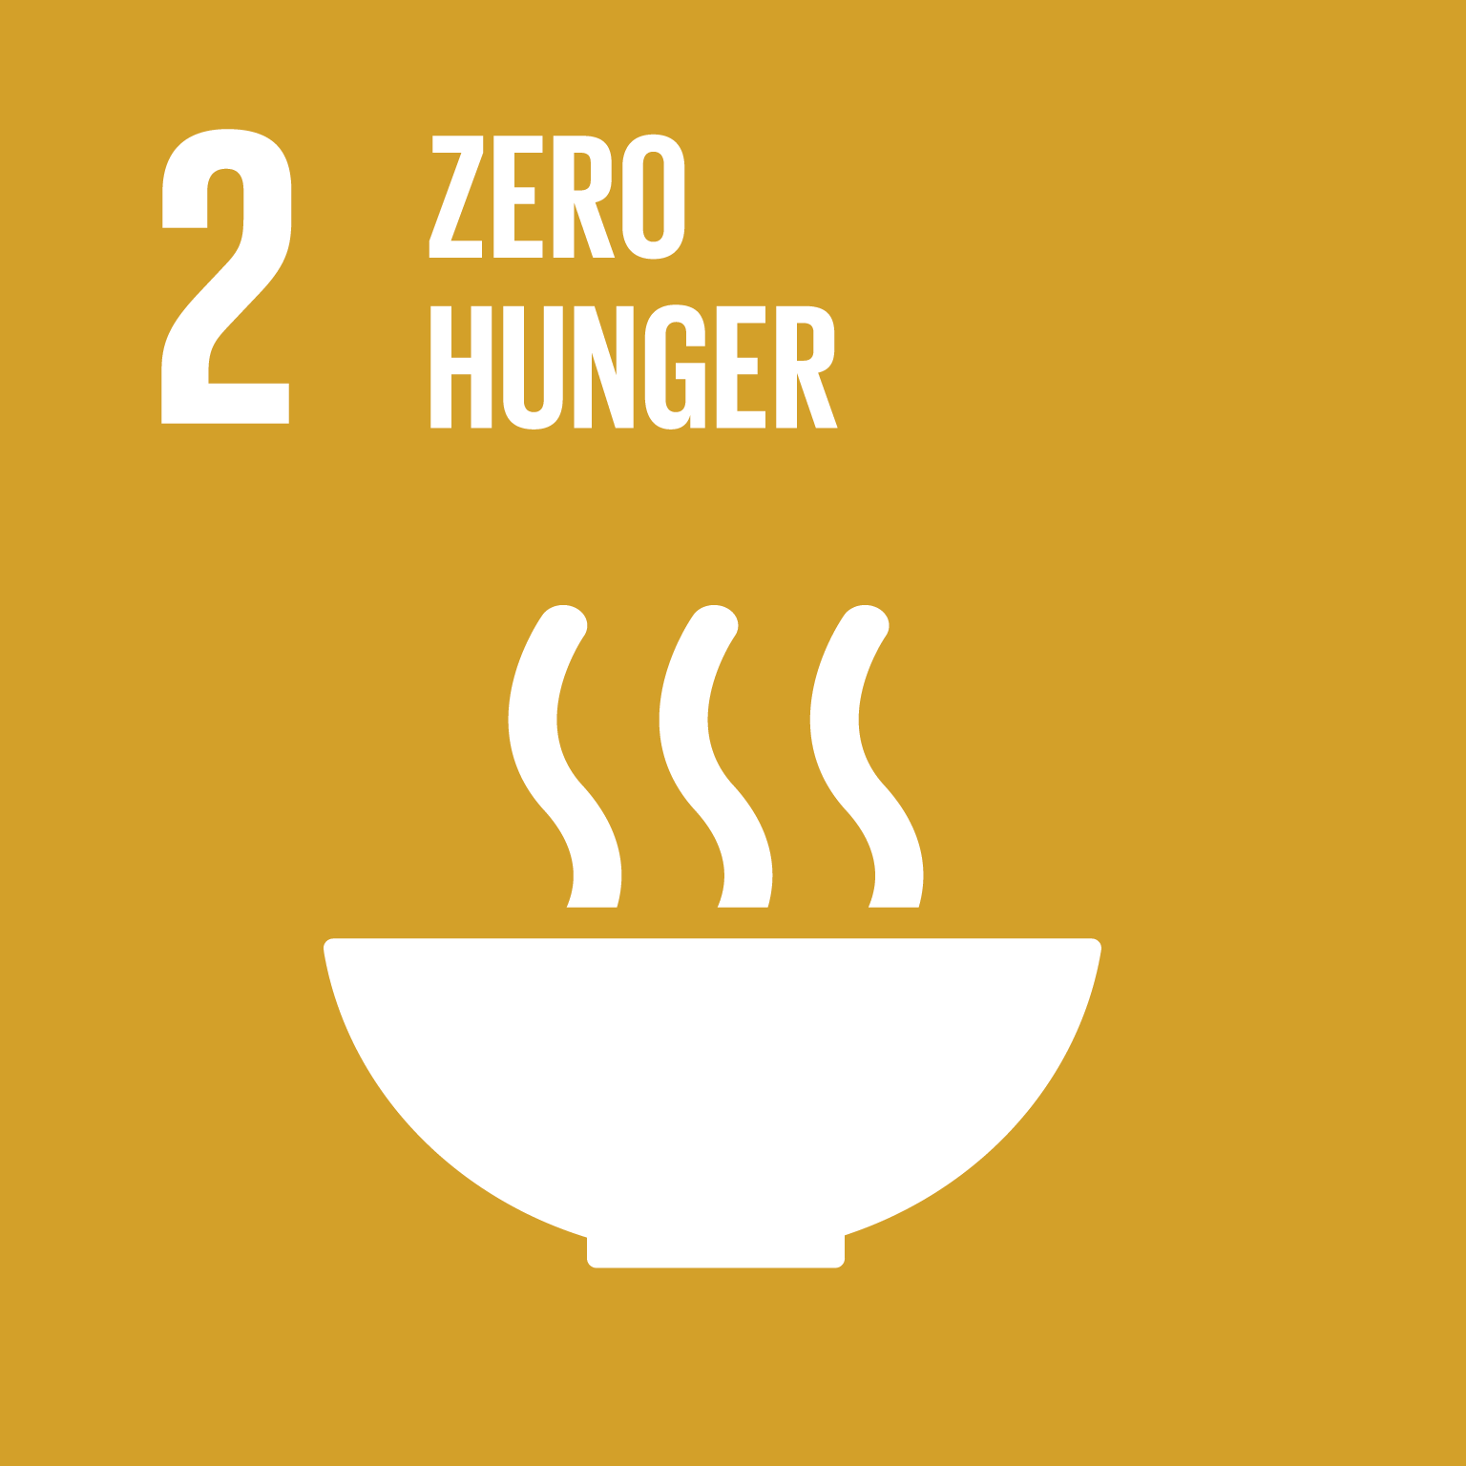
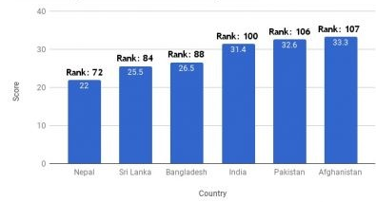
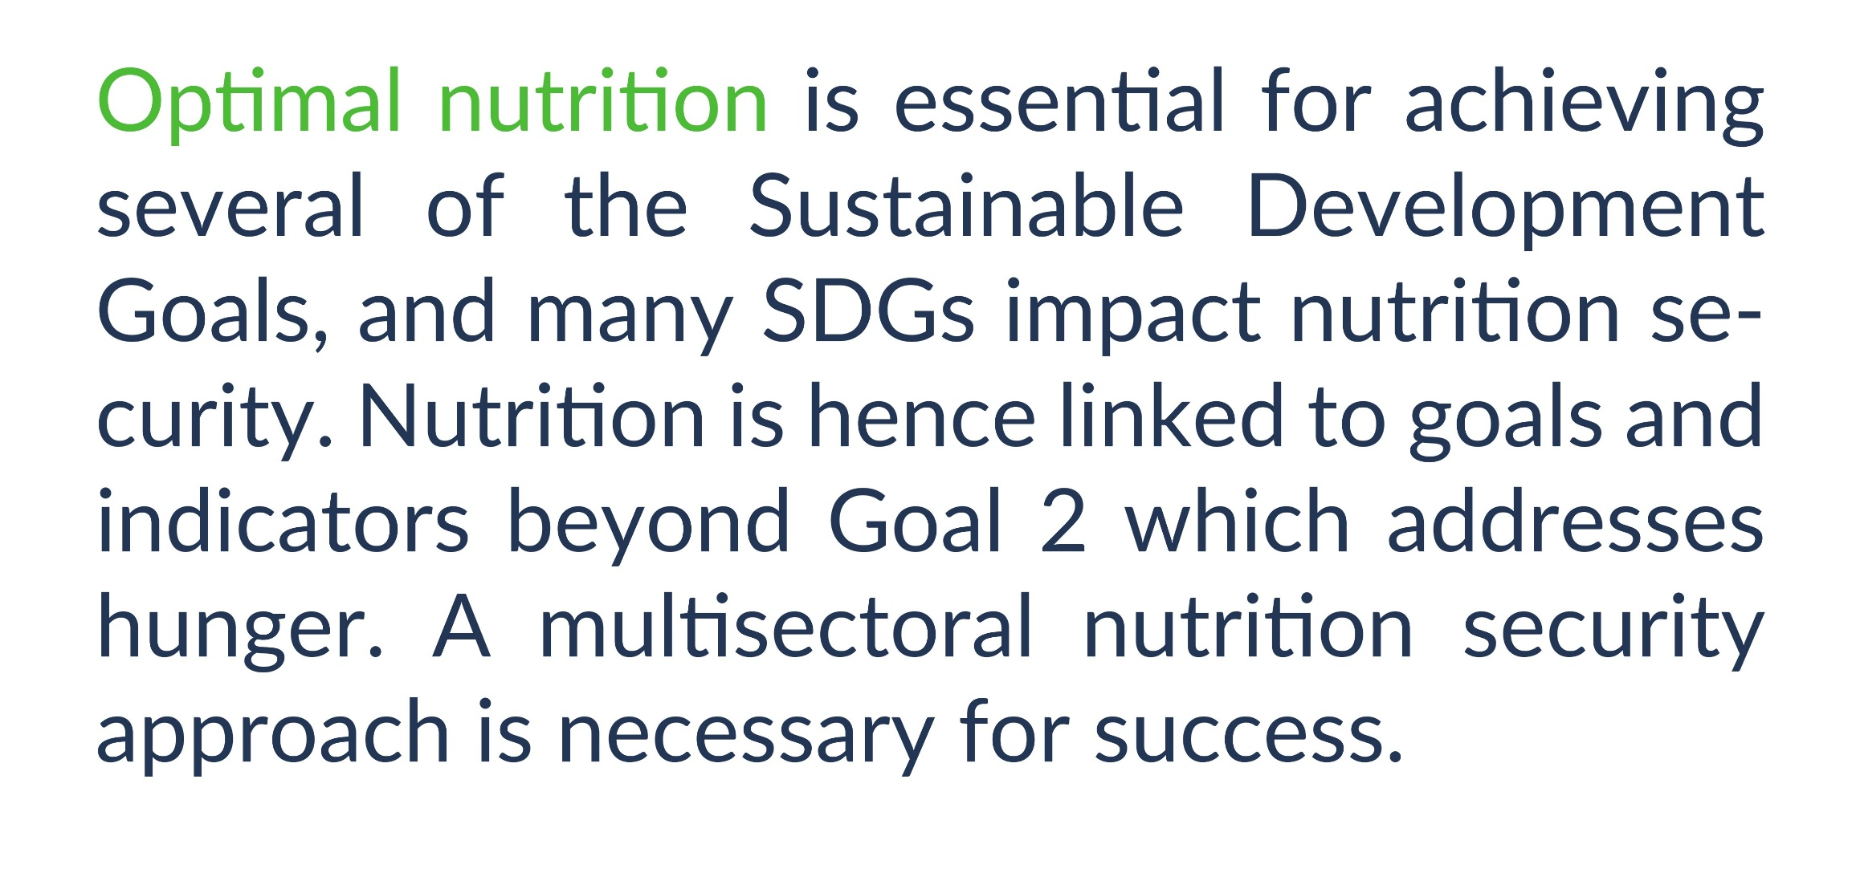
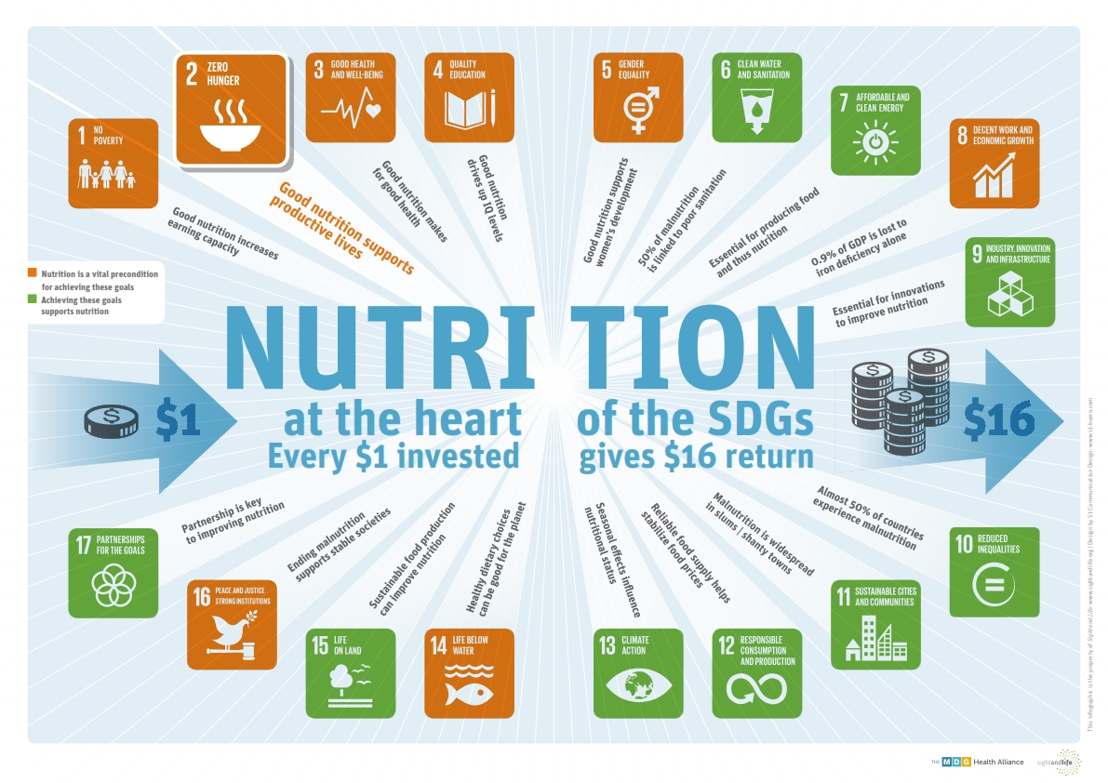
SDG 2: End hunger, achieve food security and improved nutrition and promote sustainable agriculture
Sustainable Development Goal 2
Regional Comparison (Global Hunger Index)
Programs to fight hunger and improve nutrition in Pakistan
Pakistan’s National Food Security Policy 2018 aims at promoting sustainable food production systems by an average growth rate of 4% with goals of improving food availability, accessibility and sustainability.
Benazir Income Support Program (BISP) and the World Food Programme (WFP) have partnered to improve education enrolment through revitalizing the school meal system, to improve emergency preparedness response mechanism, to enable the social protection of Pakistan and to make Pakistan more nutrition-sensitive by working on Nutrition Conditionality Program
Universal Salt Iodisation (USI) Program launched in 110 districts through Public Private Partnership
Food Fortification Program in Pakistan (FFP) setup to provide support to adequately fortify essential food elements and help the government to improve food fortification regulatory system and raise awareness to formulate policies to combat micronutrient deficiencies in Pakistan.
National Fortification Alliance (NFA) and Provincial Fortification Alliances established by all provinces in 2016
GOAL: By 2030, end hunger and ensure access by all people, in particular the poor and people in vulnerable situations, including infants, to safe, nutritious and sufficient food all year round
By 2030, double the agricultural productivity and incomes of small-scale food producers, in particular women, indigenous peoples, family farmers, pastoralists and fishers, including through secure and equal access to land, other productive resources and inputs, knowledge, financial services, markets and opportunities for value addition and non-farm employment
Asia is the continent with the most hungry people – two thirds of the total; of which Southern Asia faces the greatest hunger burden, with about 281 million undernourished people
Pakistan is ranked at 106 among 119 developing countries in the Global Hunger Index (GHI) 2017
Tharparkar region of Pakistan has the highest level of malnourishment
Agriculture plays a key and direct role in achieving SDG 2 and is also central to achieving SDG1 on eradicating extreme poverty, and several other targets, especially those related to health, water, biodiversity, sustainable cities, sustainable energy, and climate change.
Achieving the “zero hunger” vision requires social protection and food systems that are economically efficient, socially inclusive, and environmentally sustainable.
Global Hunger Index – Pakistan and Regional countries
Optimal Nutrition – Achieving SDGs
Microfinance and Food Security
There are between 450 and 500 million smallholder farmers in the world. Together with their households, this represents 2,000 million individuals*.
These are not a homogeneous group: some are involved in subsistence farming while others thrive as a true business and are integrated in structured value chains
Although their needs are not the same, they all are confronted with the problem of insufficient access to good-quality financial services.
In total, the credit needs of 270 million small farmers living in Latin America, Sub-Saharan Africa and South and South-East Asia are estimated at $200,000 million per year**. At present, barely a quarter of these needs are being met, and half of these through “informal circuits”.
Access to proper financial services is an essential condition to modernize farms and reach the second Sustainable Development Goal (SDG 2): eradicating hunger in the world.
*Christen, Peck & Anderson, ‘‘Segmentation of Smallholder households: Meeting the range of Financial Needs in Agricultural Families’’, CGAP, April 2013.
**“Inflection Point: unlocking growth in the era of farmer finance”, Initiative for Smallholder Finance and Rural & Agricultural Finance Learning Lab, April 2016. This estimate excludes China, Central Asia, the Middle East, North Africa and Eastern Europe.

Slide 7
The Economics
The Economy
Banking Sector
Microfinance Sector
Commercial Banking Sector
Microfinance Sector
As per the State Bank of Pakistan’s quarterly report issued in April 2018, Pakistan’s economy continues to depict sound fundamentals. The report highlighted that the growth in revenue collection outpaced the increase in expenditures in 1HFY18, which led to a broad-based improvement in fiscal indicators. The overall fiscal deficit was contained at 2.2% of GDP, down from last year’s 2.5%.
However, as per SBP, the Balance of Payments challenges warrant concerted and timely measures to preserve the macroeconomic stability and growth momentum.
In just the 1HFY18, the rupee depreciated by 5% against the USD and another 6% post December until April-18. Moreover, the current account deficit increased to USD 7.4b in H1-FY18, from USD 4.7b last year. Even though financial inflows were higher this year, they were insufficient to off-set the rise in the current account deficit. Consequently, SBP’s liquid reserves came under pressure; on May 4, 2018, the SBP reserves were reported at USD 17.3 billion.
Given the uptick in the economic activity, private sector credit increased by 17% over one year ended March-18. CPEC related investments and the overall improved economic environment have led to growth in lending activities. In addition to greater credit appetite of domestic industries, consumer financing has also increased in recent periods.
On the profitability side, low interest rates have squeezed spreads on private lending while maturity of high yielding PIBs is also putting a drag on the banking sector earnings. With reduced internal capital generation and imposition of higher level of risk weights on non-rated exposures beyond pre-defined thresholds, the Capital Adequacy Ratios of banks are likely to come down in the medium term.
Commercial banks continue to rely largely on the traditional brick and mortar approach. With the rise of use of technology, it remains to be seen if the traditional banking models will be challenged in the coming years.
The microfinance sector has closed the year 2017 with 5.8m borrowers, an increase of 26% over the last year, with gross loan portfolio standing at Rs. 202.7b.
Growth continues to remain concentrated in Punjab and Sindh while access to credit or financial services in general remains fairly restricted in Balochistan and KPK provinces. Given the past experience of some microfinance operators in these marginalized areas, targeted incentives may need to be introduced to bring the hitherto untapped into the net of formal financial services.
MFBs, which are regulated by the SBP, are allowed to raise public deposits while non-bank institutions remain reliant on secondary sources of funding. Some non-deposit raising institutions which mobilize savings from their clients are required to place them with licensed commercial banks. As can be seen from the table below, the volume of savings has also increased manifolds in the last few years. As per latest financial statements of 5 largest MFBs (in terms of volume of deposits), more than one-third have been mobilized from corporate entities/financial institutions. While the potential is huge both in terms of transactions and deposit generation, so far only about 10% of the total savings volumes have been raised by way of m-wallets.
Data Point* | Value
GDP per capita (current) - FY17 | $1,800
GDP (at current market prices) – FY17 | $294b
Trade Balance – Mar’18 | ($22.3b)
Public External Debt – Dec’17 | $ 88.9b
Total Liquid FX Reserves – May’18 | $ 17.3b
CPI – Apr’18 (YoY) | 3.7%
6-month KIBOR – May 14th | 6.51%
Data Point* | Value
Advances – Apr’18 | Rs. 6.81tr
Deposits – Apr’18 | Rs. 12.3tr
ADR – Apr’18 | 55.3%
Net Infection Ratio– Dec’17 | 0.9%
Risk Weighted CAR – Dec’17 | 15.3%
Credit to Private Sector % Total Scheduled Banks’ Credit – Dec’17 | 65%
 | 2017 | 2016 | 2015 | 2014
Penetration Rate (%) | 28.3 | 22.3 | 13.7 | 11.5
Active Borrowers (In m) | 5.8 | 4.6 | 3.8 | 3.1
Gross Loan Portfolio (Rs. in b) | 202.7 | 136.9 | 93.0 | 66.8
PAR-30 (%) | 0.1 | 1.4 | 1.4 | 1.1
Value of Savings (Rs. in b) | 186.9 | 121.4 | 64.7 | 43.5
Number of Policy Holders (In m) | 7.31 | 5.9 | 4.6 | 3.8
Economic and financial sector data sourced from SBP’s website; Microfinance data sourced from PMN’s website

